Slide 1
Data Analytics Challenge
By: Mohamed Hakim
Joe Schweizer
Joe Throne
Pete Mollica

Slide 2
Lockheed Martin Challenge
Goal: Reduce Insider Threat
Provided with employee records (Personal Contact Records, Travel Records, Phone Records, Performance Records, Citizenship Records, and Server Access Logs).
Have to use predictive analysis to provide each employee with a threat level. (Inconsistent phone records, or flight plans)
Identify top potential insider threats, for each department, and company wide.

Slide 3
Approach
Examine each record individually.
Provide an employee a threat level for each record.
Weight each threat level per record accordingly.

Slide 4
Main Function
We open the excel document using a read function
On the basic information page we gather our searching criteria
We save all of this criteria to an employee class
This class is very important because we use it in all of the functions
We save all of the information for each class in the main
After we have iterated through the entire list of employees and assigned a threat level, we write the output to a .csv

Slide 5
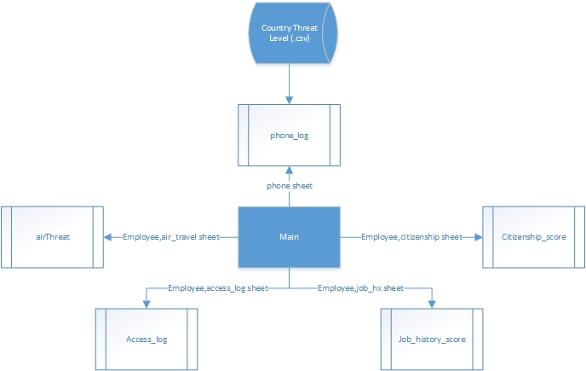

Slide 6
Individual Records
We analyzed a few different records we were given
Phone records
Travel history
Citizenship
Server access logs
Job History

Slide 7
Phone Records
The level of threat for phone records was defined by two records
Was the number a unique number, and how long was the call
Where was the source of the call, and where was the destination
Software Walkthrough
Checks for phone numbers occurring once
Checks the length of call
Assigns threat level based off source and destination
Returns arrays with employee names
Results are stored in the employee class

Slide 8
Travel History
Threat level for air travel was defined by one record
How many flights the person booked in a single day
Software Walkthrough
Import employee class to function
Checks the travel record for flights relating to employee name
If multiple booked on the same day, increase threat level
Returns a threat probability and saves it to the class

Slide 9
Citizenship
The citizenship threat was defined by one record
Where was the person born
Software Walkthrough
Import the employee class to get name of employee
Searches through citizenship tab to locate employee
Pulls from excel document the employee’s birth place
Assigns them a threat level based on their country of origin

Slide 10
Server Access Log
The Server access threat was determined by one record
How many times in a calendar year someone accessed the server
Software Walkthrough
Again using the employee class to get corresponding NTID to name
Search for each occurrence of the NTID and record it
Iterates until the NTID changes
Records the amount of times employee accessed and assigns threat level
Returns the threat and saves it to the class

Slide 11
Job History
The job history threat determined by one record
How have their performance reviews been
Software walkthrough
Imports the employee class to use each employee’s name
Searches through the document for the employee name
Checks comments for each review (All from a drop down)
Each string has different threat level
Averages all the threats and saves to employee class

Slide 12
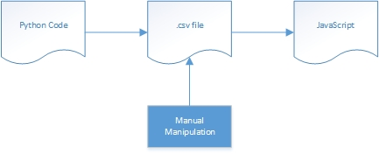
THE END
http://104.131.39.157/

